Slide 1








CitiPower, Powercor & United Energy - EV customer journey
Step 1 – Preliminary Site feasibility
Step 2 – Power offer and Licencing
Step 3 – Permit to work
Step 4 – Build and energisation
Journey step
Touch point
Inputs + Outputs
Submission location
Submission of Customer preferred sites
Distributor completes feasibility checks
Site confirmed, customer submits power and licence request
Inputs received and licence issued
Request for Permit to work and prepare for site build
No Go Zone assesses application and issues permit
Site built and application for energisation
Energisation
Day 1
+ 7 days
TBC by customer
+ 20 days
TBC by customer
+ 20 days
TBC by customer
+ 15 Days
Customer submits excel sheet containing preferred site information (address, pole numbers, GPS co-ordinates, and preferred charger pole orientation).
Distributor to completes assessment determining if customers preferred pole is suitable for EV installation and whether power is available onsite.
Excel sheet is emailed back to customer.
Customer applies for a supply offer and a FAA licence to install the charger. For CitiPower and Powercor sites, a power offer must also be selected at the same time of licence application.
Distributor reviews site, completes required checks, issues licencing and power offer. Distributor sets up billing and where applicable issues invoicing to customer.
Customer is used power offer and formal licence.
Customer applies for No Go Zone Permit to work in the vicinity of electrical assets.
Customer prepares for site build.
No Go Zone reviews application and certificates of staff onsite. No Go Zone issues permit to work in the vicinity of electrical assets
Customer builds site. Customer’s Registered Electrical Contractor applies for electricity energisation by submitting request in MySupply and including licence and supply offer.
Connections team reviews application, Retailer submits service orders, Electrical Inspector inspects site components and then issues job to crews for connection and installation of the electrical meter.
Submissions enquiry’s can be sent to facilitiesaccess@powercor.com.au
CitiPower and Powercor feasibility applications to be submitted at https://customer.portal.powercor.com.au/mysupply
United Energy applications to be submitted at https://www.unitedenergy.com.au/general-enquiry/
Licencing approval timeframe is subject to all required information being included in the application.
CitiPower and Powercor applications to be submitted at https://customer.portal.powercor.com.au/mysupply
United Energy applications to be submitted at https://www.unitedenergy.com.au/general-enquiry/
No Go Zone Permit to work approval timeframe is subject to all required information being included in the application.
CitiPower and Powercor applications to be submitted at https://customer.portal.powercor.com.au/mysupply
United Energy applications to be submitted at https://myenergy.ue.com.au/s/login/
Connection of electricity is subject to electrical inspection. Connections to be applied via portals:
CitiPower and Powercor applications to be submitted at https://econnect.portal.powercor.com.au/customer/loginpage
United Energy applications to be submitted at https://myenergy.ue.com.au/s/login/
Each site is required to follow the above sequencing in the correct order unless the pole is not owned by CitiPower Powercor or United Energy then licencing shall be skipped..
07/04/2025
The CitiPower Powercor United Energy EV customer journey
1

Slide 2
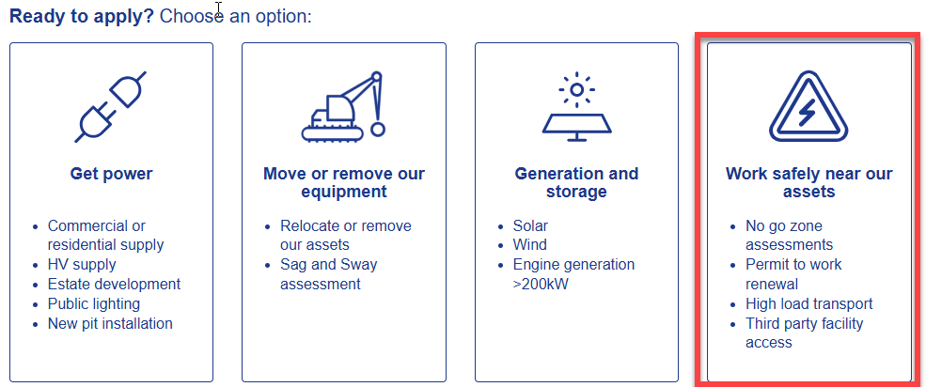
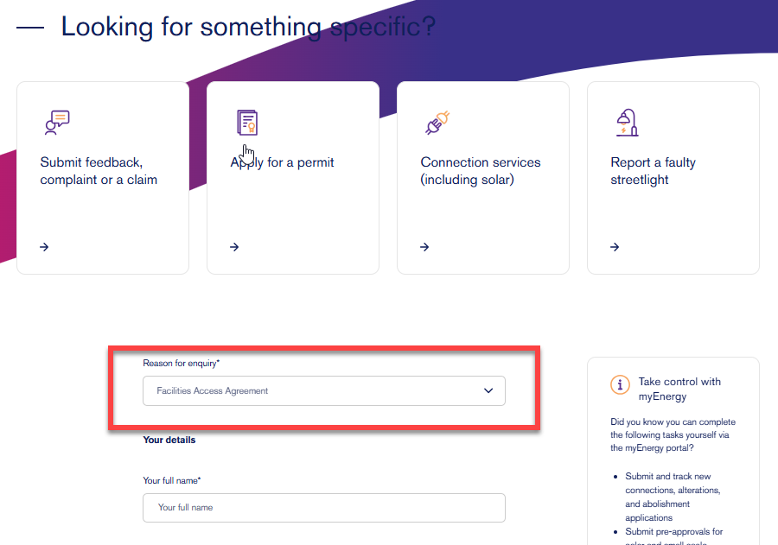
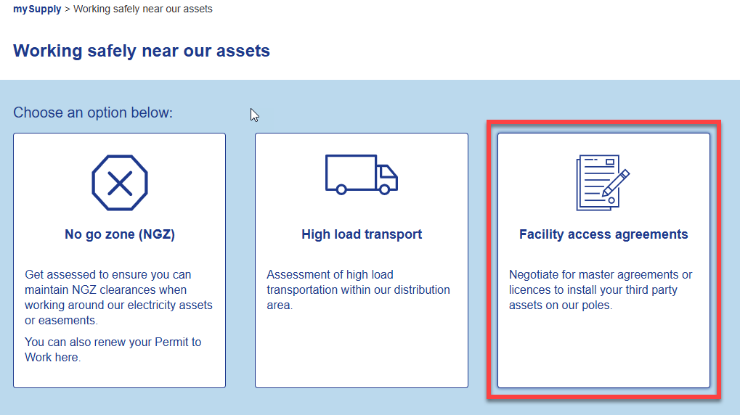
EV Charger Application Process
Step 1 - Feasibility
What Happens? | .
Action, Requirements and General information
Feasibility is the first step in the process designed to provide customers with a preliminary check that the site and pole is suitable for use. Upon submission of potential sites, the distributor assesses candidate sites against agreements standards and guidelines to determine if the proposed location can house an EV charger. The Distributor also completes a preliminary check of onsite distribution assets to determine if there is an adequate power supply available.
Upon receiving the feasibility spreadsheet, the distributor will perform a high-level assessment of the poles suitability to house the EV charger and supply availability. Multiple pole candidates may be submitted, however, primary and back up sites should be labelled accordingly.
Submissions should be made in MS Excel format and include the following information:
Pole number (identified by label on front of pole).
Nearest site address
GPS Co-ordinates
Preferred orientation of device.
Site feasibility success is subject to the criteria set by internal standards, VESI Shared use of poles code, VESI Service and Installation Rules and the EV charger customer site selection guidelines.
The distributor will review the primary site and any secondary sites to ensure:
The location, and the pole is suitable for the EV charger.
The pole has an adequate available power.
The orientation of the charger provides safe access for our crews.
The distributor will provide a response outlining suitable sites where EV chargers are able to be installed.
CitiPower and Powercor applications to be submitted at https://customer.portal.powercor.com.au/mysupply and then clicking on ‘Work Safely Near Our Assets’, then clicking on ‘Facility Access Agreements’
Screenshot of application submission area below.
United Energy applications to be submitted by lodging an enquiry at https://www.unitedenergy.com.au/general-enquiry/ and then changing the general enquiries drop down box to ‘Facilities Access Agreement’ and then inputting all required information.
Screenshot of application submission area below. Please note that this will also apply for lodging a request for a licence
Please note – Standard timeframe for licence processing is 7 business days from submission of a complete application.
07/04/2025
The CitiPower Powercor United Energy EV customer journey
2

Slide 3
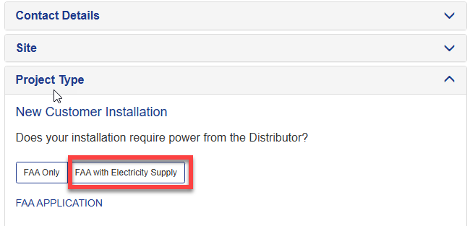
EV Charger Application Process
Step 2 - Power Offer and Licencing
What Happens? | .
Action, Requirements and General information
Customer applies for a licence and or Power offers to install assets on the distribution pole. The application is assessed by the distributor and executed in line with the Master Facilities Access Agreement.
Applying for a power offer provides the customer with certainty the required is available and will remain available until a connection is made. If there is no power available, it provides the distributor with a mechanism to augment the network subject to approval of cost.
Power Offer (CitiPower and Powercor only): is to be submitted at the time of applying for a facilities access licence. When completing your application under the ‘Project Type’ tab it will provide the option to select ‘FAA with Electricity supply’, By selecting this and inputting the relevant details you will be requesting a power offer.
Once you have received your power offer, you will need accept this by returning a signed copy.
Screen shot below indicating ‘FAA with Electricity supply’.
All Facility Access Agreement (FAA) applications for licenses should be submitted via the following links:
CitiPower and Powercor applications to be submitted at https://customer.portal.powercor.com.au/mysupply
United Energy applications to be submitted at https://www.unitedenergy.com.au/general-enquiry/, the Facilities Access Agreement should be selected from the drop-down menu.
The below documentation must be contained within annexure 2 section of the licence :
Utility Pack /Redline drawings of charger
Details of clearances to any other assets on the pole.
Details of the attachment methods and any brackets.
Single line drawings of all electrical components.
A design sheet detailing required labelling and signage.
Upon review of these sites, a unique license number will be allocated, the customer will then receive a completed licence and access offer.
The customer must execute and return the licence in line with the requirements of their Master Facilities Access Agreement.
The Facilities Access Licence: will bind your EV charger to the Master Facilities Access Agreement and is required for all sites. Upon execution of a licence any applicable charges will be raised via invoice.
A template of the licence can be found in schedule 4 of your Master Facilities Access Agreement.
CitiPower and Powercor applications to be submitted at https://customer.portal.powercor.com.au/mysupply and then clicking on ‘Work Safely Near Our Assets’, then clicking on ‘Facility Access Agreements’
Screenshot of application submission area referenced in Step 1 - Feasibility.
United Energy applications to be submitted by lodging an enquiry at https://www.unitedenergy.com.au/general-enquiry/ and then changing the general enquiries drop down box to ‘Facilities Access Agreement’ and inputting all required information. Screenshot of application submission area referenced in Step 1 - Feasibility.
Successful completion of a Facilities Access Licence grants the customer rights to install an EV charger on the selected pole. This licence is bound to the Master Facilities Access Agreement and is critical to ensuring that the site becomes connected.
Please note – Standard timeframe for licence processing is 20 business days from submission of a complete application.
07/04/2025
The CitiPower Powercor United Energy EV customer journey
3

Slide 4
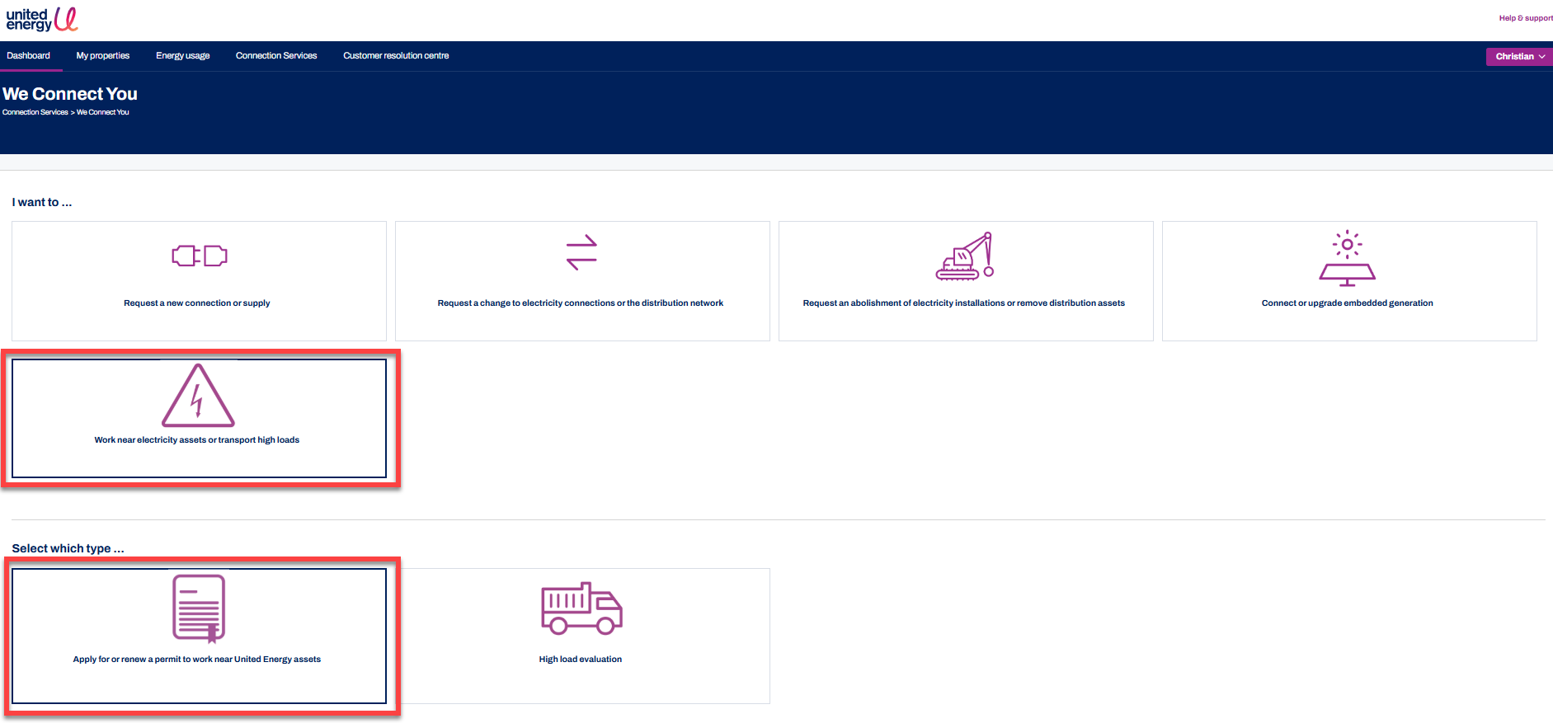
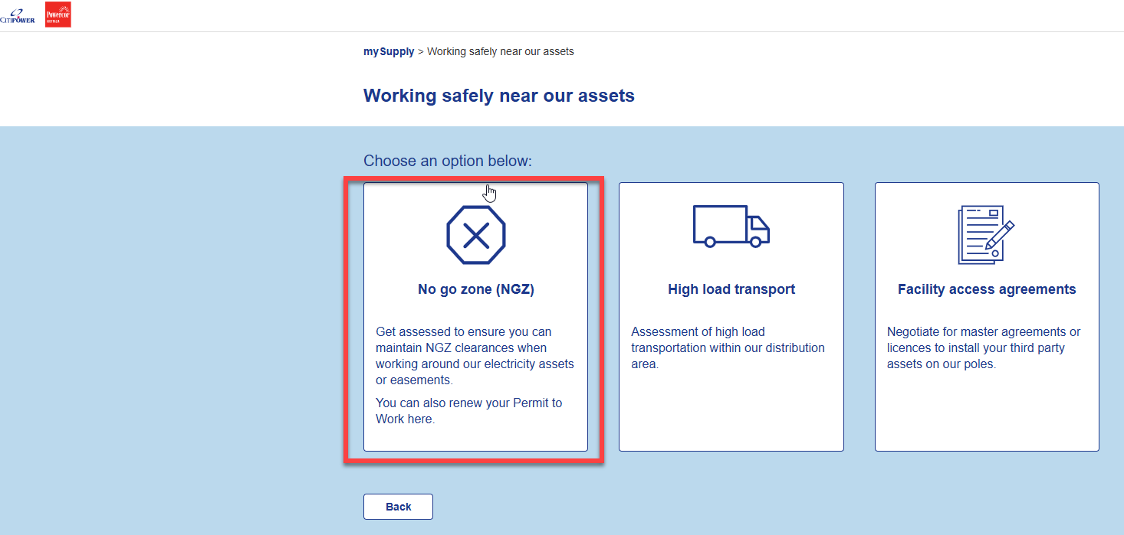
EV Charger Application Process
What Happens? | .
Action, Requirements and General information
Step 3 - No Go Zone - Permit to work
The EV Charger build team applies for a permit to work in the vicinity of electrical assets.
Our No Go Zone teams assess the application, work zone and work methods to determine the site can be built safely and adequate distance is maintained between people, plant and the electricity assets. Once a permit to work is issued, crews may begin attaching assets to the distribution pole.
Before you start work near a distributors overhead or underground network, you may need a permit to work detailing the conditions and methods you must adhere to in order to carry out your work safely and comply with Worksafe and ESV regulations. An application needs to be submitted anytime your above-ground works are within 6.4m of distribution assets, or your underground works are within 2m of distribution assets
Before applying you should have the following in place.
SWMS
JSA
Traffic management procedure
Permit to install mains cables in public space or a relevant exemption.
Permit to work requests can be made by lodging an application at the following links:
CitiPower and Powercor applications to be submitted at https://customer.portal.powercor.com.au/mysupply
United Energy applications to be submitted at https://myenergy.ue.com.au/s/login/
Timeframe: Please be aware that this application may be subject to a fee. The permit to work (if granted) will be issued approx. 30 days from payment.
Please note – Standard timeframe for licence processing is 20 business days from submission of a complete application.
CitiPower and Powercor applications to be submitted at https://customer.portal.powercor.com.au/mysupply and then clicking on ‘Work Safely Near Our Assets’, then clicking on ‘No Go Zone’. Screenshot of CitiPower and Powercor application submission area below
United Energy applications to be submitted by lodging an enquiry at https://myenergy.ue.com.au/ and then selecting, ‘New application’ then “Work Near electrical assets and “ Apply for or renew a permit to work near United Energy assets’
Screenshot of United Energy application submission area below.
After the permit has been issued:
When you are operating equipment near our electricity assets, our permits detail the conditions and methods you must adhere to in order to carry out the proposed work on site safely. If a permit to work is granted, you will be responsible for ensuring that a copy of this permit is always on site in either digital or hard copy form. You will also be responsible for ensuring that all members of your work crews are briefed on the conditions of the permit to work.
07/04/2025
The CitiPower Powercor United Energy EV customer journey
4

Slide 5
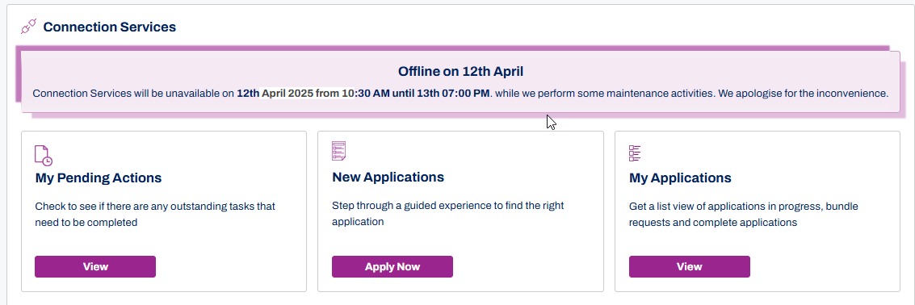
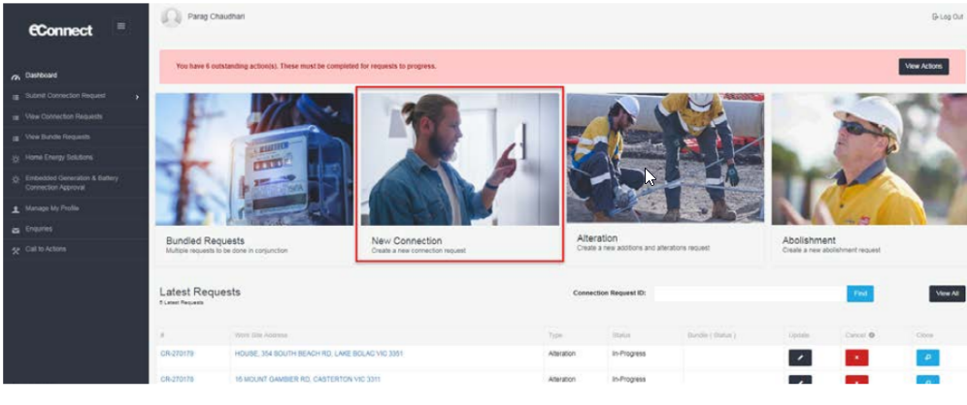
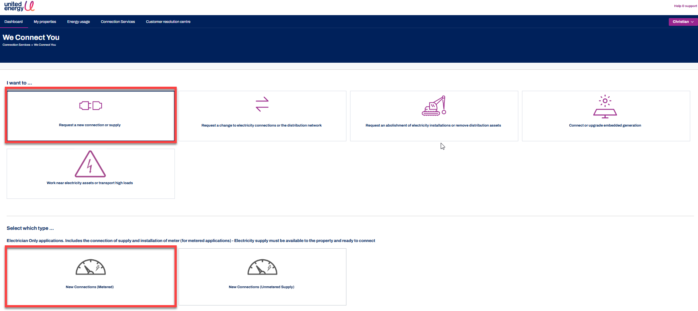
EV Charger Application Process
Step 4 - Energisation
What Happens? | .
Action, Requirements and General information
The final step in the process is to energise the EV charger. Majority of these process steps will be handled by your Registered Electrical Contractor (REC). Upon submission of the energisation request, we will liaise with your electricity retailer, our inspectors and crews to energise the site and install any metering required.
Before you lodge an energisation request, the EV operator should contact their preferred retailer to establish an account and then ensure their Registered Electrical Contractor is aware of the retailer account number as this will be needed to complete the electricity connection application.
Lodging a request for meter installation and energisation.
After your Registered Electrical Contractor has completed installing the charger and its associated electrical components, they must obtain a Prescribed Certificate of Electrical Safety (PCES).
Your Registered Electrical Contractor can then apply for energisation by lodging a request via our online portals and including the supply offer, licence, PCES and an underground cable drawing (PRV).
Once the application is submitted our teams will reach out to the nominated electricity retailer and request that they submit the required retailer service orders for a meter and energisation.
The electricity retailer will then submit the required service orders, which our team will process and dispatch a Licenced Electrical Inspector to the site for review.
If the site is free from non-conformances, the Licenced Electrical Inspector will release the service order to our crews for installation of the meter and energisation.
CitiPower and Powercor applications to be submitted at https://econnect.portal.powercor.com.au/customer/loginpage
United Energy applications to be submitted at https://myenergy.ue.com.au/s/login/
Helpful tip: To ensure the connection address is correct and matches across all documentation and PCES – copy the address over from the Supply Offer. If there is no Supply Offer such as in the case of United Energy sites, a typical address for a electricity pole is written as O/S 25 JOHN ST, MELBOURNE.
Applying for connection in United Energy is as simple as logging into https://myenergy.ue.com.au/s/login/ and selecting the ‘New Application’ tile. From here select the ‘New connection (metered) tile and complete all required fields.
Applying for connection in CitiPower and Powercor is as simple as logging into https://econnect.portal.powercor.com.au/customer/loginpage and selecting the ‘New Connection’ tile. From here select metered service and complete all required fields.
Please note – Standard timeframe for connection processing is 15 business days from submission of a complete application and receiving all applicable service orders from your preferred electricity retailer.
07/04/2025
The CitiPower Powercor United Energy EV customer journey
5

